Slide 1



Microsoft Fabric
Sessão 4 Pipelines e Data Flow Chão de Fábrica
Armando Lacerda
Azure Cloud Architect Independent Consultant
Tiago Balabuch
Cloud Solutions Architect
Notes:
Both

Slide 2
Agenda
Revisão
Pipelines
Data flows

Slide 3








OneLake
Data Factory
Data Warehouse
Data Engineering
Data Science
Real Time Analytics
Data Activator
Power BI

Slide 4
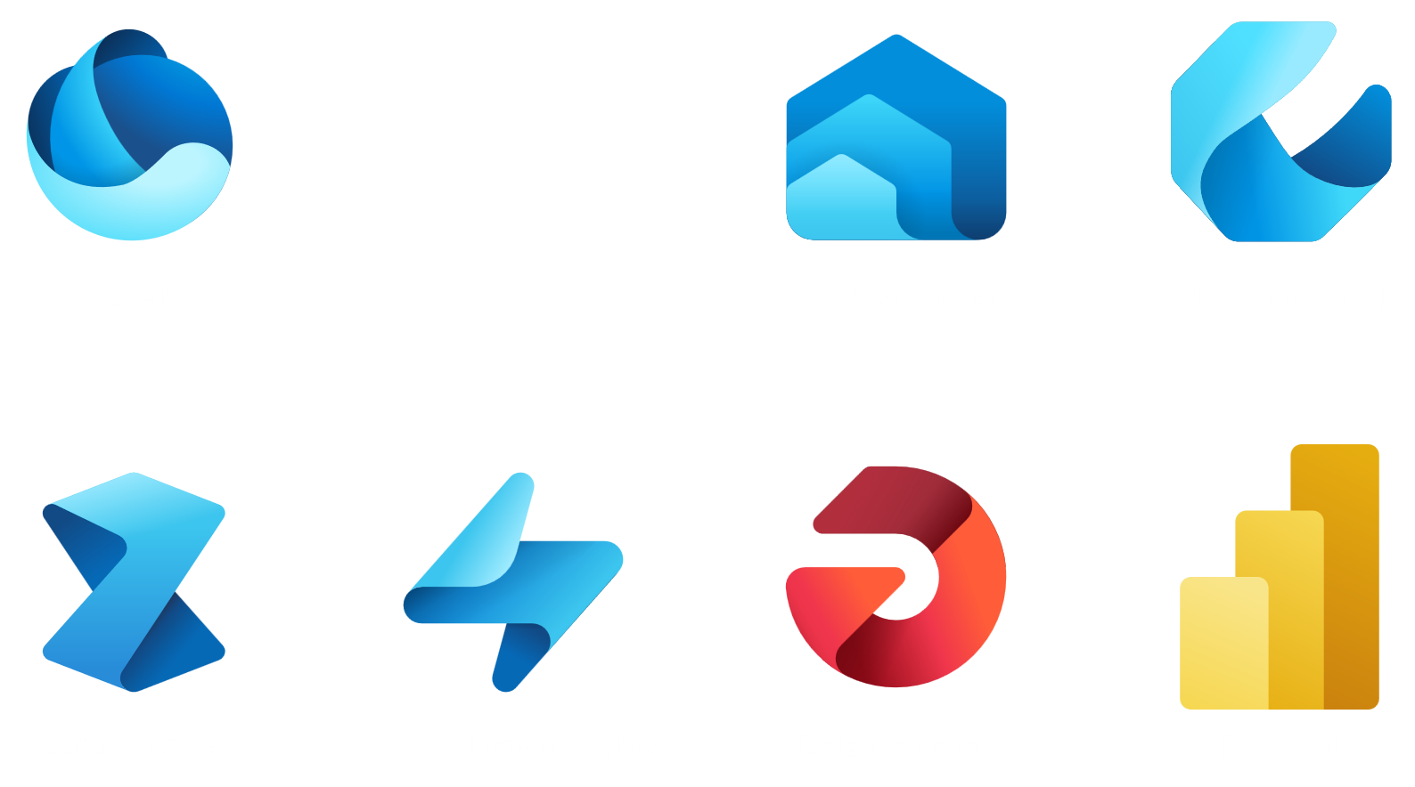
Data Factory

Slide 5
Ingest data with Dataflows
Transform data with Power Query
Build workflows with Data Pipelines

Slide 6
Dataset

Slide 7
Activity
Dataset

Slide 8
Activity
Dataset
Pipeline

Slide 9
Demos

Slide 10
Nos vemos na próxima sessão.
Armando Lacerda
Azure Cloud Architect Independent Consultant
Tiago Balabuch
Cloud Solutions Architect
Notes:
Armando and Tiago

